Slide 1
Business Plans
Barringer Chapter 4
Notes:
https://cob-viewcs02.bus.oregonstate.edu/

Slide 2

Ba 260 Lecture 4
How to charge people
Stripe
Square Stand
$99 and process credit cards right out of the box. Starts at 2.75% per swipe for Visa, MasterCard, Discover, and American Express.
Online
2.75%

Slide 3

Ba 260 Lecture 4
How to charge people
PayPal
From $0 to $3,000 monthly
2.9% + $0.30 per transaction
$3,000 to $10,000 monthly
2.5% + $0.30 per transaction

Slide 4

Ba 260 Lecture 4
How to charge people
Venmo
Free money transfer
No business functions yet

Slide 5
Ba 260 Lecture 4
Pre-built Sites
Sites
Shopify
SquareSpace
Pros
Ready to go
Security concerns are minimal
Cons
Harder to customize
Costs to use

Slide 6

Ba 260 Lecture 4
Duncan Bannatyne (Link)
Born in Dalmuir (West of Glasgow)
Childhood lived in house with 6 other families
Shared one room with parents and siblings
Dropped out of school at 15
In 1964 joined Royal Navy for 12 years
After several years was dishonorably discharged
Spent 9 months in military detention
Notes:
29

Slide 7

Ba 260 Lecture 4
Duncan Bannatyne
Spent most of twenties at small jobs like vehicle fitter, tractor repair,
Lived on island of Jersey for 4 years
Worked as deckchair attendant, ice cream seller, hospital porter
At 30 did not have a bank account
Notes:
29

Slide 8

Ba 260 Lecture 4
Duncan Bannatyne
Moved to Stockton-on-Tees
Opened ice cream van (450 pounds)
Sold for (28,000 pounds)
Opened Quality Care Homes
Sold for (26 million pounds)
Opened Bannatyne Health and many more businesses
Notes:
29

Slide 9
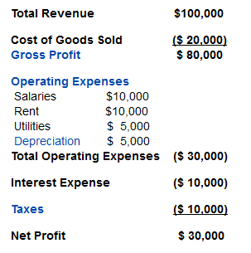
Income Statements

Slide 10

Ba 260 Lecture 4
Business Plan
A business plan is a written narrative, typically 25 to 35 pages long, that describes what a new business plans to accomplish.
Dual-Use Document
For most new ventures, the business plan is a dual-purpose document used both inside and outside the firm.

Slide 11
Ba 260 Lecture 4
There are two primary audiences for a firm’s business plan
Audience
What They are Looking For
A Firm’s Employees
A clearly written business plan helps the employees of a firm operate in sync and move forward in a consistent and purposeful manner.
Investors and other external stakeholders
A firm’s business plan must make the case that the firm is a good use of an investor’s funds or the attention of others.

Slide 12
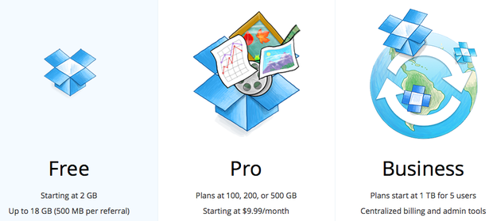
Ba 260 Lecture 4
Structure of the Business Plan
To make the best impression a business plan should follow a conventional structure, such as the outline for the business plan shown in the chapter.
Although some entrepreneurs want to demonstrate creativity, departing from the basic structure of the conventional business plan is usually a mistake.
Typically, investors are busy people and want a plan where they can easily find critical information.
Sense of Excitement
Along with facts and figures, a business plan needs to project a sense of anticipation and excitement about the possibilities that surround a new venture.

Slide 13
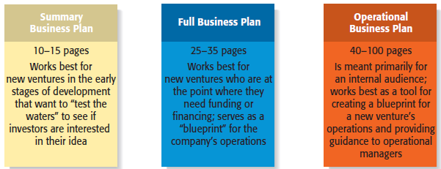
Ba 260 Lecture 4
Content of the Business Plan
The business plan should give clear and concise information on all the important aspects of the proposed venture.
It must be long enough to provide sufficient information yet short enough to maintain reader interest.
For most plans, 25 to 35 pages is sufficient.
Types of Business Plans

Slide 14

Ba 260 Lecture 4
Recognizing the Elements of the Plan May Change
It’s important to recognize that the plan will usually change while written.
New insights invariably emerge when an entrepreneur or a team of entrepreneurs immerse themselves in writing the plan and start getting feedback from others.

Slide 15
Business Plan Walk Through

Slide 16
Ba 260 Lecture 4
Section 1: Executive Summary
The executive summary is a short overview of the entire business plan
It provides a busy reader with everything that needs to be known about the new venture’s distinctive nature.
An executive summary shouldn’t exceed two single-spaced pages.
Key Insights
In many instances an investor will
ask for a copy of a firm’s executive
summary and will ask for a copy of
the entire plan only if the executive
summary is sufficiently convincing.
The executive summary, then, is
arguably the most important
section of a business plan.

Slide 17

Ba 260 Lecture 4
Section 2: Industry Analysis
This section should begin by describing the industry the business will enter in terms of its size, growth rate, and sales projections.
Items to include in this section:
Industry size, growth rate, and sales projections
Industry structure
Nature of participants
Key success factors
Industry trends
Long-term prospects

Slide 18

Ba 260 Lecture 4
Section 2: Industry Analysis
Key Insights
Before a business selects a target market it should have a good grasp of its industry—including where its promising areas are and where its points of vulnerability are.
The industry that a company participates in largely defines the playing field that a firm will participate in.

Slide 19

Ba 260 Lecture 4
Section 3: Executive Summary
Company Description
This section begins with a general description of the company.
Items to include in this section:
Company description
Company history
Mission statement
Products and services
Current status
Legal status and ownership
Key partnerships (if any)

Slide 20
Ba 260 Lecture 4
Key Insights
Section 4: Market Analysis
The market analysis breaks the industry into segments and zeros in on the specific segment (or target market) to which the firm will try to appeal.
Items to include in this section:
Market segmentation and target market selection
Buyer behavior
Competitor analysis
Most start-ups do not service their
entire industry. Instead, they focus
on servicing a specific (target)
market within the industry.
It’s important to include a section in
the market analysis that deals with
the behavior of the consumers in the
market. The more a start-up knows
about the consumers in its target
market, the more it can tailor its
products or services appropriately.

Slide 21
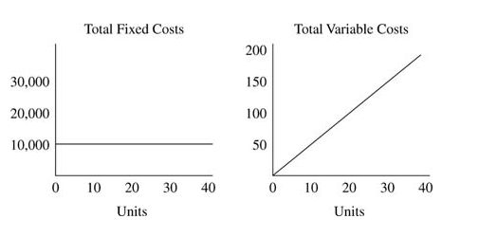
Ba 260 Lecture 4
Section 5: The Economics of the Business
This section addresses the basic logic of how profits are earned in the business and how many units of a business’s profits must be sold for the business to “break even” and then start earning a profit.
Items to include in this section:
Revenue drivers and profit margins
Fixed and variable costs
Operating leverage and its implications
Start-up costs
Break-even chart and calculations

Slide 22

Ba 260 Lecture 4
Section 6: Marketing Plan
The marketing plan focuses on how the business will market and sell its product or service.
Items to include in this section:
Overall marketing strategy
Product, price, promotions, and distribution
Sales process (or Cycle)
Sales tactics
Notes:
Half.com was founded in 1999 by American entrepreneur Josh and Sunny Balijepalli. As an advertising gimmick, in December of the same year, the company paid the town of Halfway, Oregon US$100,000 and donated 20 new computers to change its name to "Half.com, Oregon" for a year.

Slide 23
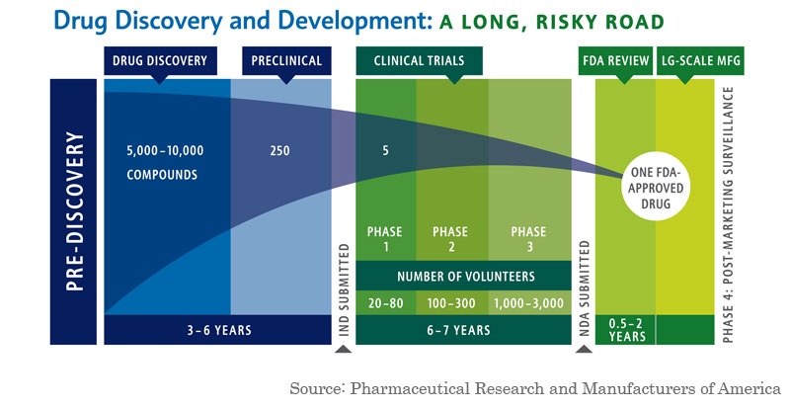
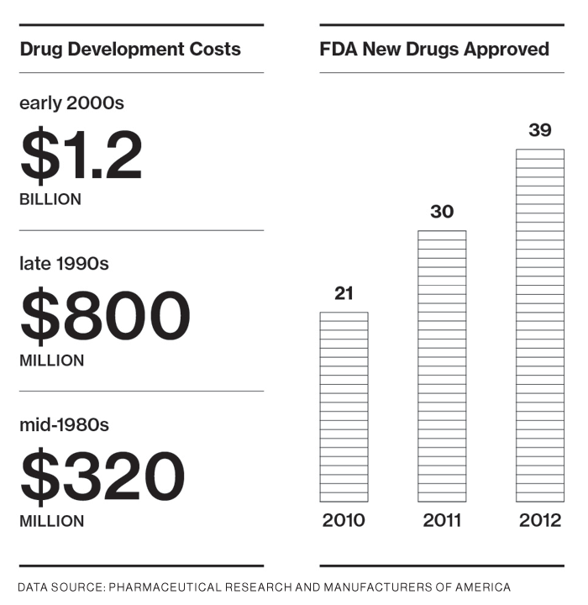
Ba 260 Lecture 4
Section 7: Design and Development Plan
If you’re developing a completely new product or service, you need to include a section in your business plan that focuses on the status of your development efforts.
Items to include in this section:
Development status and tasks
Challenges and risks
Projected development costs
Proprietary issues (patents, trademarks, copyrights, licenses, brand names)

Slide 24
Ba 260 Lecture 4
Section 8: Operations Plan
Operations Plan
Outlines how your business will be run and how your product or service will be produced.
A useful way to illustrate how your business will be run is to describe it in terms of “back stage” (unseen to the customer) and “front stage” (seen by the customer) activities.
Items to include in this section:
General approach to operations
Business location
Facilities and equipment

Slide 25

Ba 260 Lecture 4
Section 9: Management Team and Company Structure
Management Team and Company Structure
The management team of a new venture typically consists of the founder or founders and a handful of key management personnel.
Items to include in this section:
Management team
Board of directors
Board of advisers
Company structure
Starbucks CEO
Apple (Link)

Slide 26
Ba 260 Lecture 4
Section 10: Overall Schedule
A schedule should be prepared that shows the major events required to launch the business.
The schedule should be in the format of milestones critical to the business’s success.
Examples of milestones:
Incorporating the venture
Completion of prototypes
Rental of facilities
Obtaining critical financing
Starting production
Obtaining the first sale

Slide 27
Ba 260 Lecture 4
Section 11: Financial Projections
The final section of a business plan presents a firm’s pro forma (or projected) financial projections.
Items to include in this section:
Sources and uses of funds statement
Assumptions sheet
Pro forma income statements
Pro forma balance sheets
Pro forma cash flows
Ratio analysis

